Slide 1



Holiday Safety
presented by
PSU and HSE&C
Each year, thousands of people are injured in holiday decorating accidents, bp PSU and HSE&C reminds you about …

Slide 2


Tree Safety
Both real and artificial trees pose an increased risk of fire.
Here are some tips for being smart & keeping safe when it comes to your tree:
When choosing an artificial tree, be sure it’s labeled as fire-retardant.
When choosing a real tree, select the freshest-looking tree available.
Select a tree that’s an appropriate size for the room. Keep in mind that trees look smaller when they are outside and tree toppers and stands will add to the final height of the tree.
Place the tree at least three feet away from heating system air registers, fireplaces and other heat sources.
Try to position the tree near an electrical outlet to minimize the use of extension cords.
Adequately support the tree with a sturdy stand designed not to tip over.
Do not use electric lights on metallic trees. Use remote spot or reflective lights.
Do not use lighted candles or other flaming devices on or near your tree.
Whenever possible, use decorations made with flame-resistant, flame-retardant or non-combustible materials.
Unplug tree lights when out of the room and before going to sleep.
Discard the tree immediately after the holiday.
When dealing with REAL trees:
Test for freshness by grasping a branch between your thumb and forefinger and pulling it toward you. Very few needles should come off.
If you don’t plan on putting the tree up right away, make a one half inch fresh cut off the bottom of the trunk and place the tree in a five-gallon bucket of warm water. Store the tree in cool temperatures but above freezing.
Keep the water level above the cut and check the water level daily. Initially, a fresh tree may soak up to a gallon of water a day.
No water additives are necessary. Plain tap water is best.
Defective lighting, including electrical cords and plugs, cause almost half of all Christmas tree fires.
Safety tips found at: Christmas Tree Safety - FDNY Smart

Slide 3
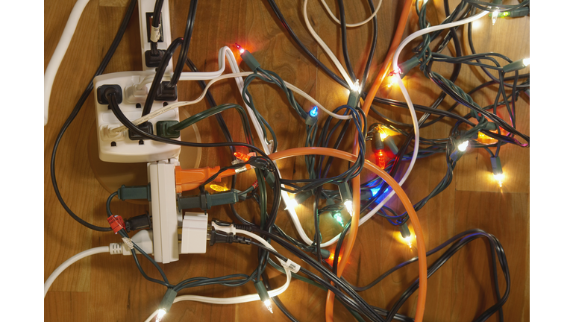

Extension Cord Safety
Do not overload extension cords or allow them to run through water or snow on the ground
Do not substitute extension cords for permanent wiring.
Do not run through walls, doorways, ceilings, or floors. If a cord is covered, heat cannot escape, which may result in a fire hazard.
Do not use an extension cord for more than one appliance.
Heavy reliance on extension cords is an indication that you have too few outlets to address your needs. Have additional outlets installed where you need them.
Multiple plug outlets must be plugged directly into mounted electrical receptacles; they cannot be chained together.
Make sure the extension cord or temporary power strip you use is rated for the products to be plugged in and is marked for either indoor or outdoor use.
The appliance or tool that you are using the cord with will have a wattage rating on it. Match this up with your extension cord, and do not use a cord that has a lower rating.
Never use a cord that feels hot or is damaged in any way. Touching even a single exposed strand can give you an electric shock or burn.
Never use three-prong plugs with outlets that only have two slots for the plug. Do not cut off the ground pin to force a fit. This defeats the purpose of a three-prong plug and could lead to an electrical shock. Never force a plug into an outlet if it doesn’t fit.
Use extension cords with polarized and/or three-prong plugs.
Buy only cords approved by an independent testing laboratory, such as Underwriters Laboratories (UL), Intertek (ETL), or Canadian Standards Association (CSA).
Safety tips found at: Extension Cord Safety Tips - Electrical Safety Foundation (esfi.org)

Slide 4


Ladder Safety
Don’t climb alone: Never climb a ladder without someone else there to watch or help. However, only one person should be on the ladder at a time unless it’s specifically designed for two people.
Don’t D&D: Don’t drink and decorate.
Be firm: Set up the ladder so that it’s on a firm and level foundation. Avoid slippery and unstable surfaces. Space the base of the ladder one foot away from the wall for every four feet of ladder height. Make sure the ladder is in good working condition, with no loose or missing parts.
Take your time: Never rush while hanging or removing holiday lights and decorations. Take the time to ensure you’re following all safety precautions.
Be aware of children: Keep kids away from ladders.
Lock it open: Always open a stepladder completely and make sure the spreader is locked open before using the ladder.
Follow the “3-Point Rule”: Always have three points of contact while on the ladder (two hands and one foot, or two feet and one hand). Grip the rungs to climb – not the side rails.
Avoid furniture: Avoid standing on chairs, couches, or other furniture when hanging or removing holiday decorations. Always use a proper stepstool or stepladder.
Choose the right ladder: Select a ladder with the proper load capacity for the job, and make sure it's long enough to work from without using the top three feet.
Inspect the ladder: Check for damage or weakness before using the ladder, especially if it's new or you haven't used it in a while.
Position the ladder carefully: Place the ladder close to your work area so you don't lose your balance.
Face the ladder: Stay in the center of the rails and grip them with both hands. Don't turn away from the ladder while climbing.
Don't stand on the top rung: Never stand on the top rung of the ladder.
Move the ladder if needed: If you need to reach too far, move the ladder instead of leaning.
Don’t slip: Keep the steps and rungs of the ladder free of water and other slippery materials.
Safety tips found at: Barrow Shares Safety Tips for Removing Holiday Decorations (barrowneuro.org)
Safety tips found at: Ladder Safety Tips for Holiday Decorating - Craig Castleman Greene, MD, MBA (craigcgreenemd.com)

Slide 5
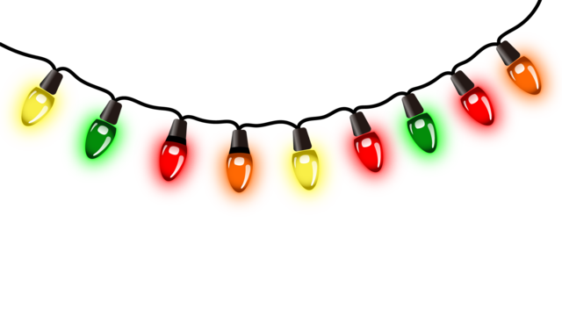
Light Safety
Make sure you're using lights that have been safety tested and approved by OSHA-certified laboratories, like Underwriters Laboratory (UL) and are appropriate for the way they'll be used.
Ensure that lights being placed outside are labeled for outdoor use.
Check all of your lights, especially older ones, for broken or cracked sockets, frayed or bare wires, or loose connections and toss any damaged sets. Inspect your extension cords as well.
Practice good extension cord safety. Never run cords under rugs or coil them tightly around themselves, which can cause them to overheat.
Consider a programmable timer to your strings of lights to ensure lights are not accidentally left on. This also helps regulate energy use and reduce cost.
Plug outdoor lights and decorations into "GFCI" grounding outlets. Portable GFCI units can be purchased where electric suppliers are sold.
Always look up before decorating outdoors. Never raise ladders or extend objects into or near power lines.
Holiday lights using light-emitting diodes (LEDs) use one-tenth the energy of traditional mini-lights and are cooler to the touch, reducing the risk of fire.
Always turn off lights when you are not home.
Use extension cords that are rated to carry the electrical loads connected to them and are rated for appropriate indoor/outdoor use.
To reduce the risk of fire, don’t overload a circuit.
Use caution not to drive nails, staples or tacks through wiring insulation.
Safety tips found at: Holiday Light Safety | Eversource

Slide 6


Gift Safety
Choose toys with sturdy construction. Avoid toys with sharp edges and points, including hard, thin plastic or metal pieces that may be attached and could cause injury.
Avoid choking hazards. Choose toys that are at least an inch in diameter and two inches in length (about the size of a toilet paper roll) so they can’t lodge in the child’s throat or mouth.
Keep older kids’ toys away from younger children. Keep small balls and other toys with small parts away from children under 3 and keep deflated balloons away from children under 8.
Don’t buy toy jewelry that may contain lead or cadmium. Both are poisonous metals that can cause serious harm to children. Watch out for older painted toys, which may also contain lead.
Avoid toys with cords or strings longer than 7 inches, as they could pose a strangulation risk for babies.
Children under 10 should get battery-operated toys, not toys that need to be plugged into an electrical outlet.
Use caution with toys that require button batteries by ensuring they are not easily accessible. If swallowed, these batteries can become lodged in the esophagus, resulting in serious injury or death.
Avoid toys with high-powered magnets that are small enough to be swallowed. If swallowed, these tiny magnets can attract each other within the body and cause serious internal injury or even death.
Include protective gear. Don’t forget a helmet with scooters, bikes or other riding toys.
Discard wrappings and plastic packaging immediately after gifts have been opened. These are NOT toys!
Stay up to date on the latest recalls. Every year, dozens of consumer products are recalled because of safety concerns.
Safety tips found at: Practice safe gift-giving this holiday season | United Health Services (nyuhs.org)

Slide 7
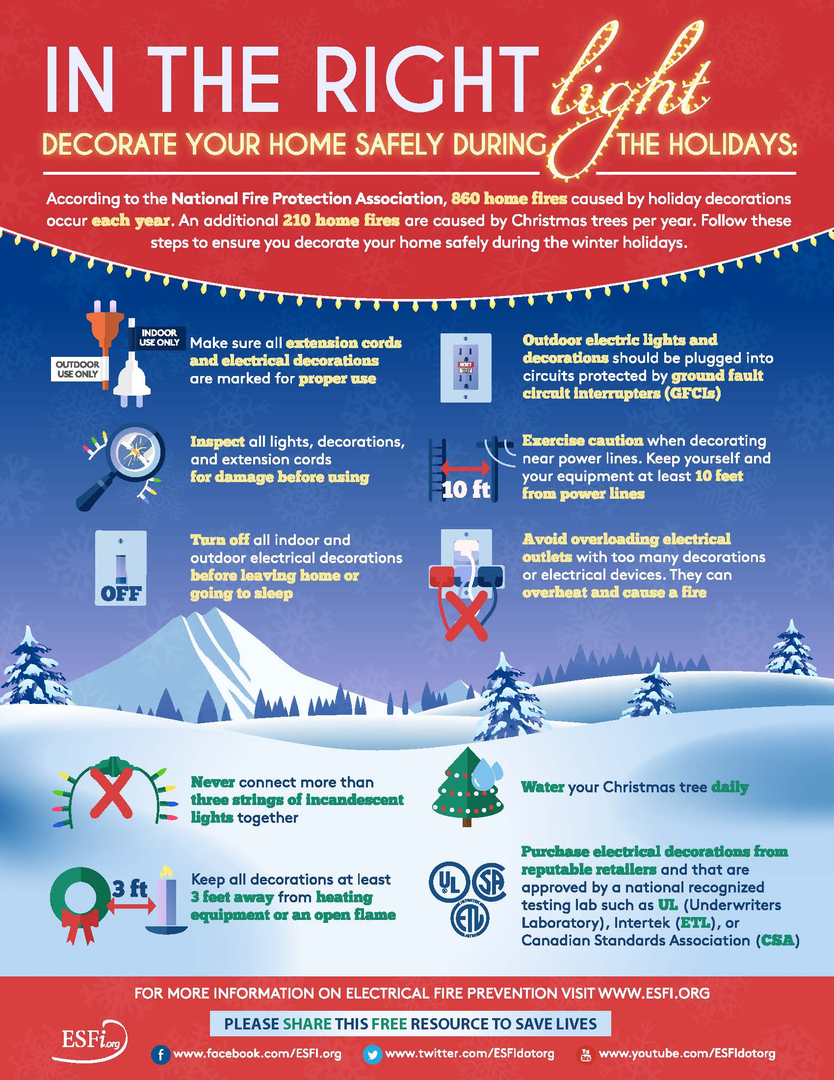
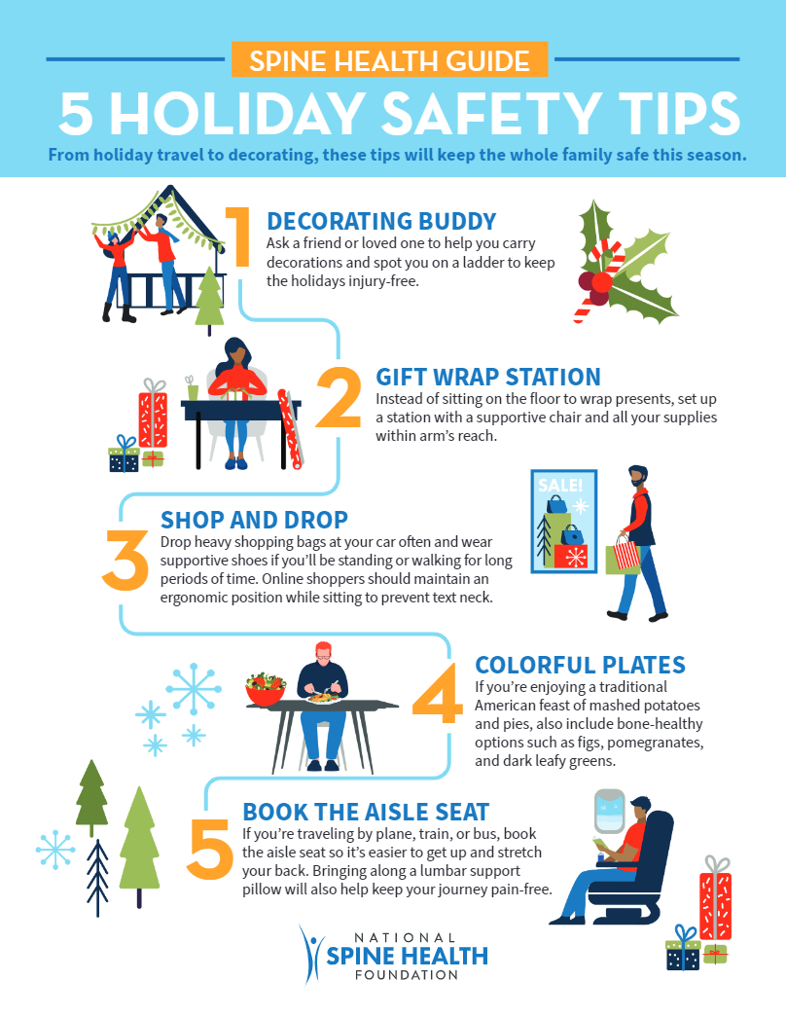

Slide 8
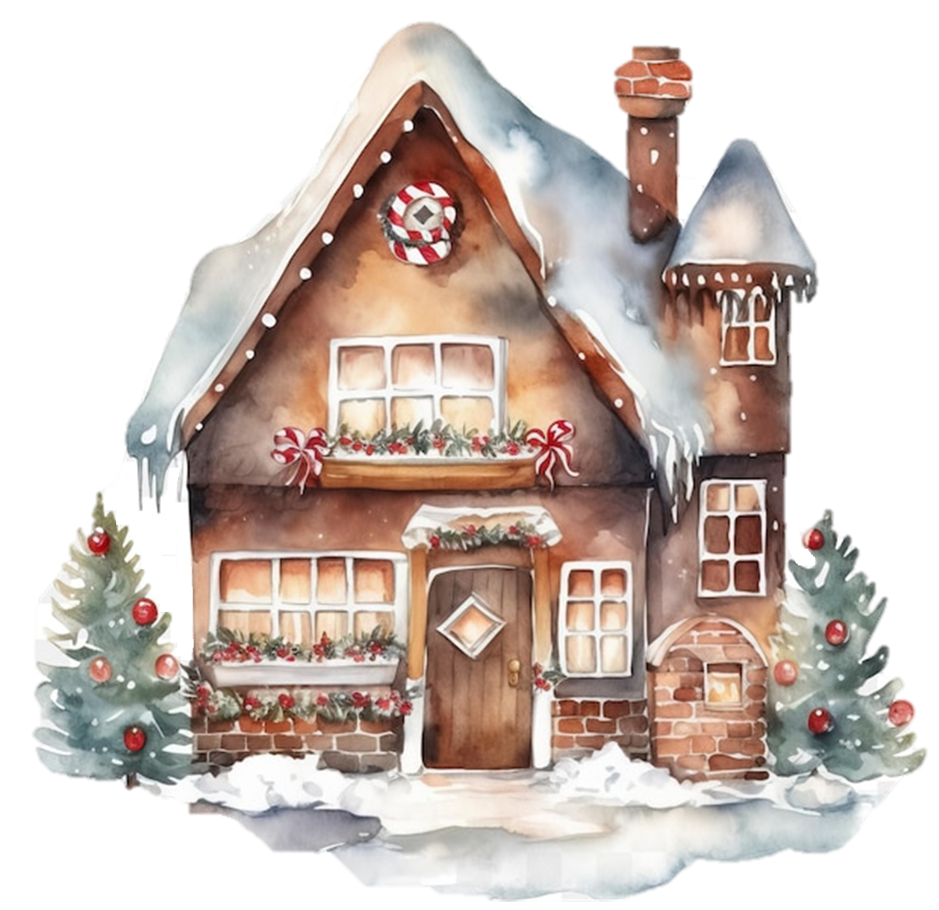
Holiday Safety
presented by PSU and HSE&C
Chris Cooley, PSM
Chris Smith, CMP/MSP
Bruce Denham, CMP/MSP
Shane Fruge, HSE&C Advisor
Marissa Zajac, PA to PSM

